Slide 1
RNAseq Minicourse
Processing Raw Reads into Counts

Slide 2
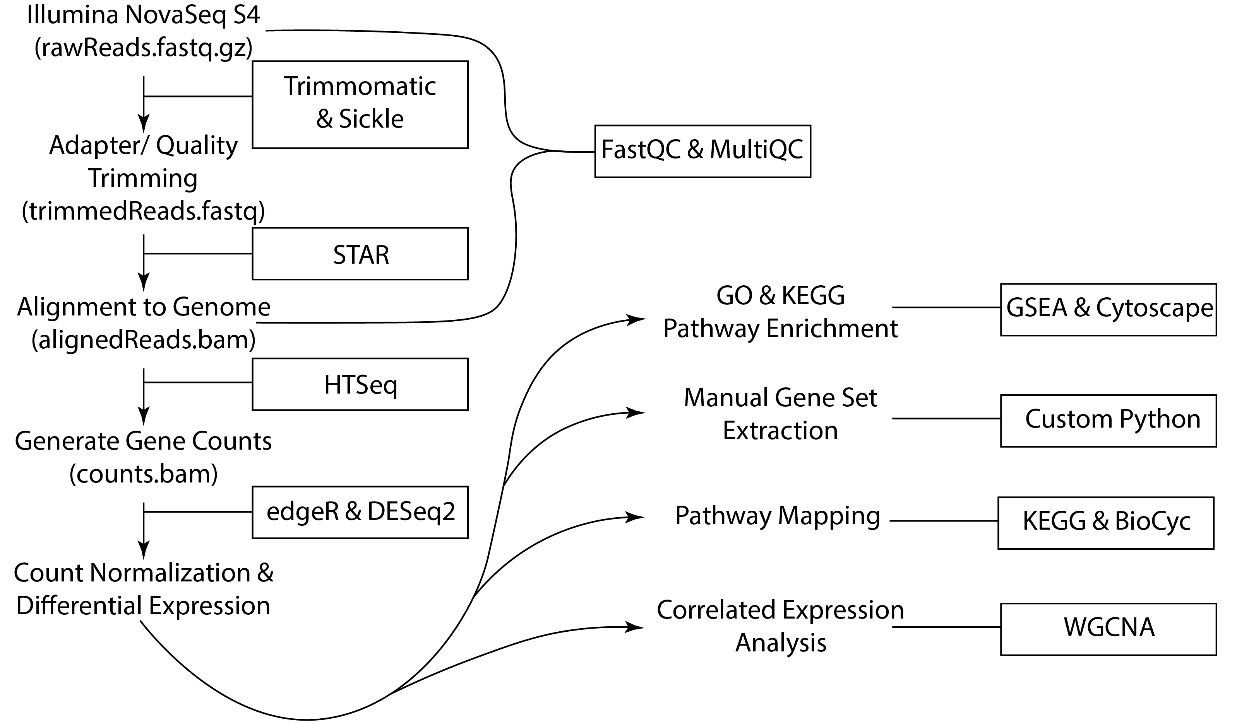
RNAseq Bioinformatic Pipeline

